Slide 1
IOT BASED SMART CAR PARKING SYSTEM
A Dissertation Submitted In Partial Fulfilment Of The Requirements For The Degree Of
Bachelor Of Technology in Electronics and Communication Engineering
Under The
Maulana Abul Kalam Azad University Of Technology
Under The Supervision of
Prof. Sonali Basak
Assistant Professor, Department of ECE, SVIST
Presented By
Alinda Pal Himanshu Prasad Arindam Dutta
(Roll no. 24100322028) (Roll no. 24100323069) (Roll no. 24100323056)
Madhumita Dutta Suvhojit Dutta Manish Talukdr
(Roll no. 24100323073) (Roll no. 24100323090) (Roll no. 24100322053)
Swami Vivekananda institute of science and technology
West Bengal
2025-2026

Slide 2
Introduction and problem statements
Introduction
The IoT-Based Smart Car Parking System is an intelligent parking solution that uses IR sensors, an ESP8266 Wi-Fi module, and the Blynk IoT platform to monitor parking spaces in real time. It enables users to check slot availability remotely, reducing parking time, traffic congestion, and fuel consumption while improving overall parking efficiency.
Problem Statement
Difficulty in finding vacant parking spaces.
Lack of real-time parking information.
Increased traffic congestion and fuel wastage.
Inefficient manual parking management.
Need for a cost-effective smart parking solution.

Slide 3
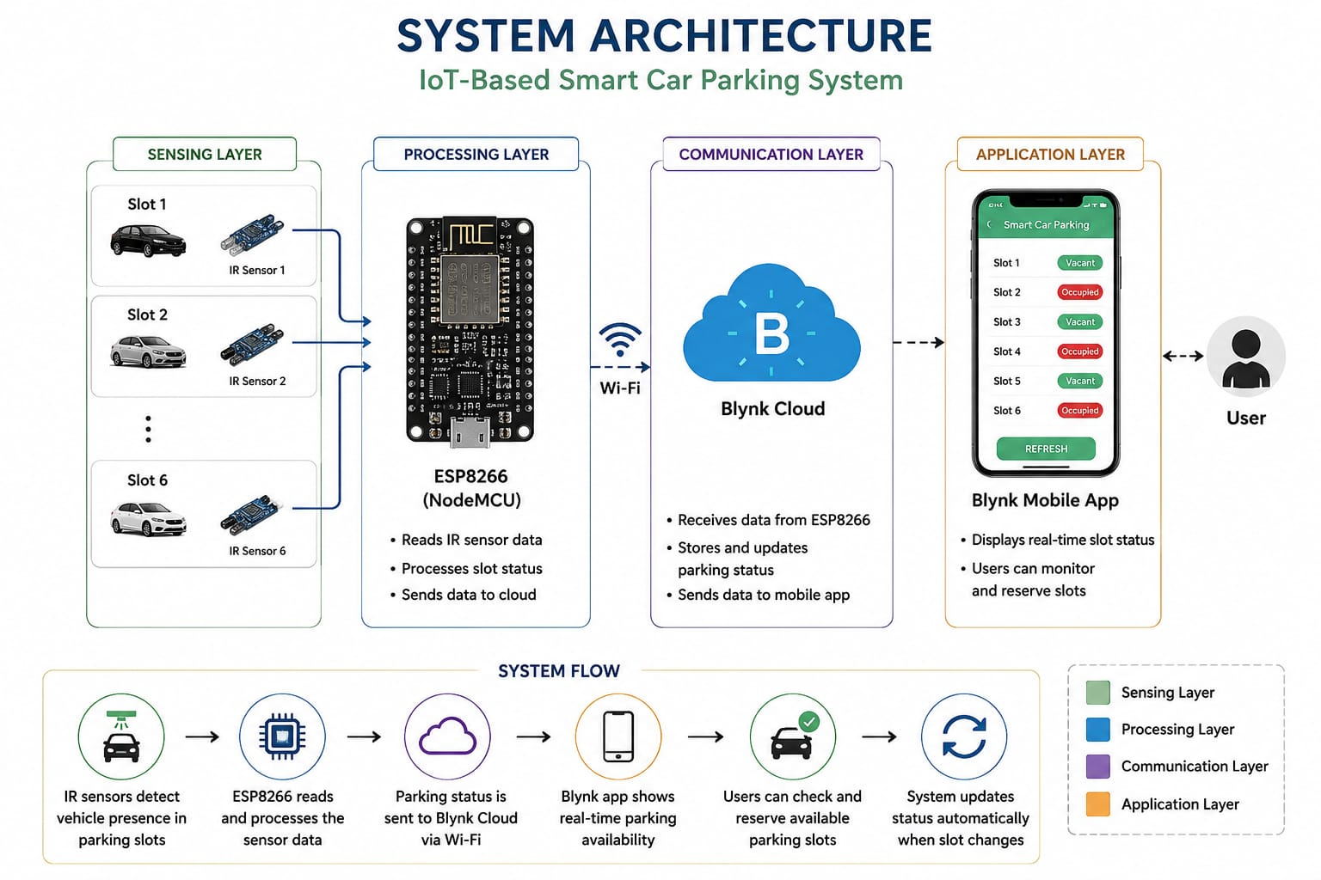
System Architecture
The IoT-Based Smart Car Parking System consists of four main layers:
Sensing Layer: IR sensors detect whether each parking slot is occupied or vacant.
Processing Layer: The ESP8266 Node MCU collects sensor data and processes the parking status.
Communication Layer: The ESP8266 transmits the processed data to the Blynk Cloud via Wi-Fi.
Application Layer: The Blynk mobile application displays real-time parking availability and allows users to monitor and reserve parking slots remotely.

Slide 4
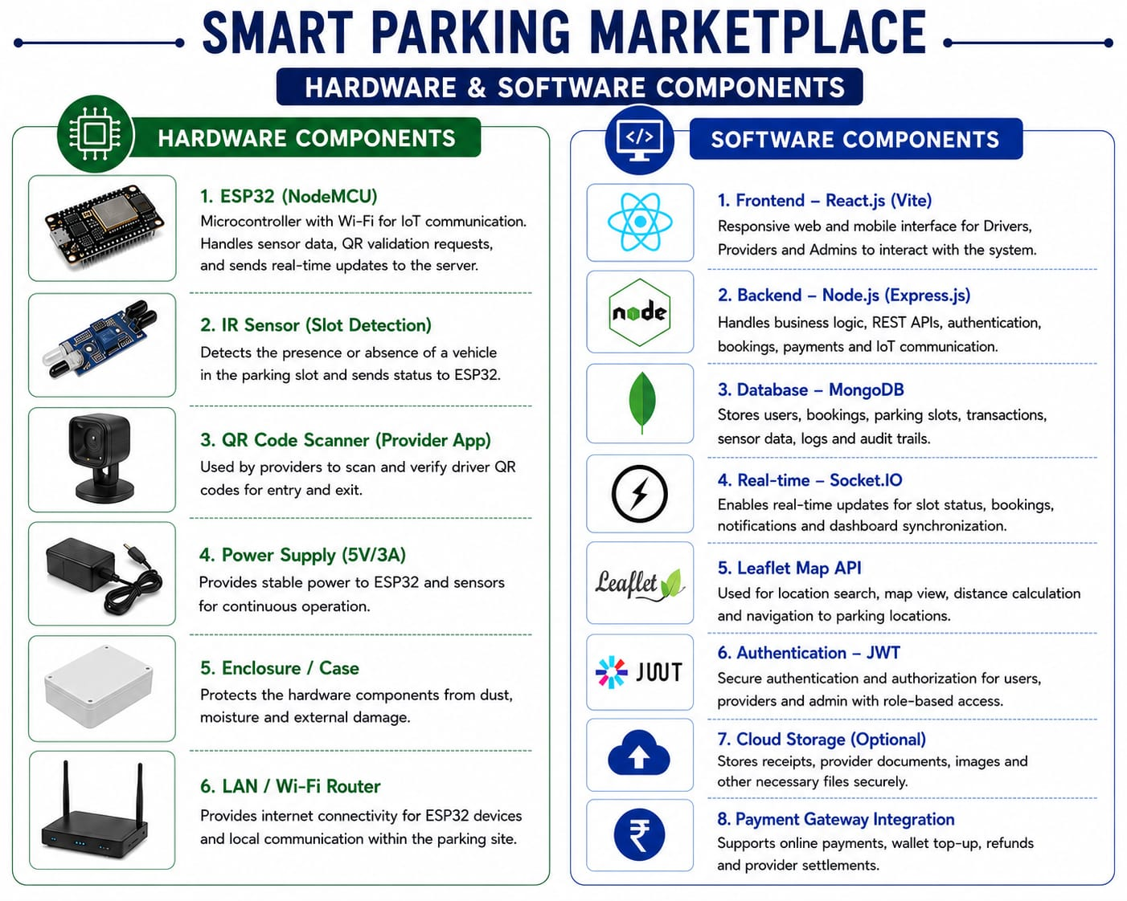
Hardware and software components

Slide 5
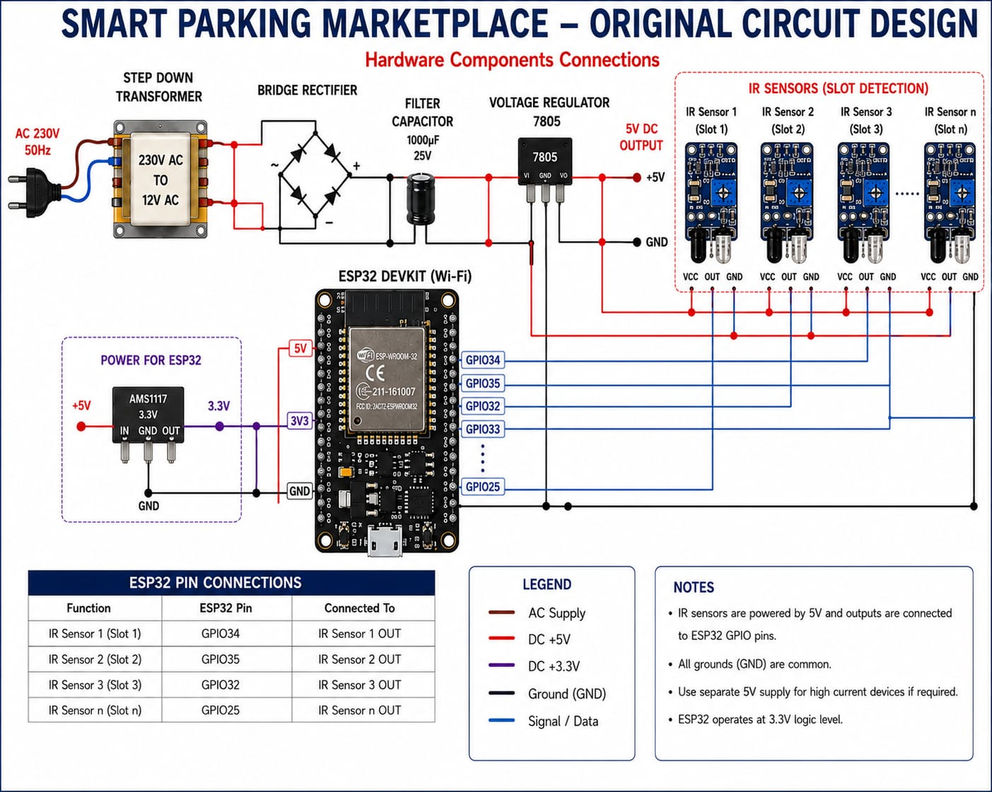
Circuit diagram

Slide 6
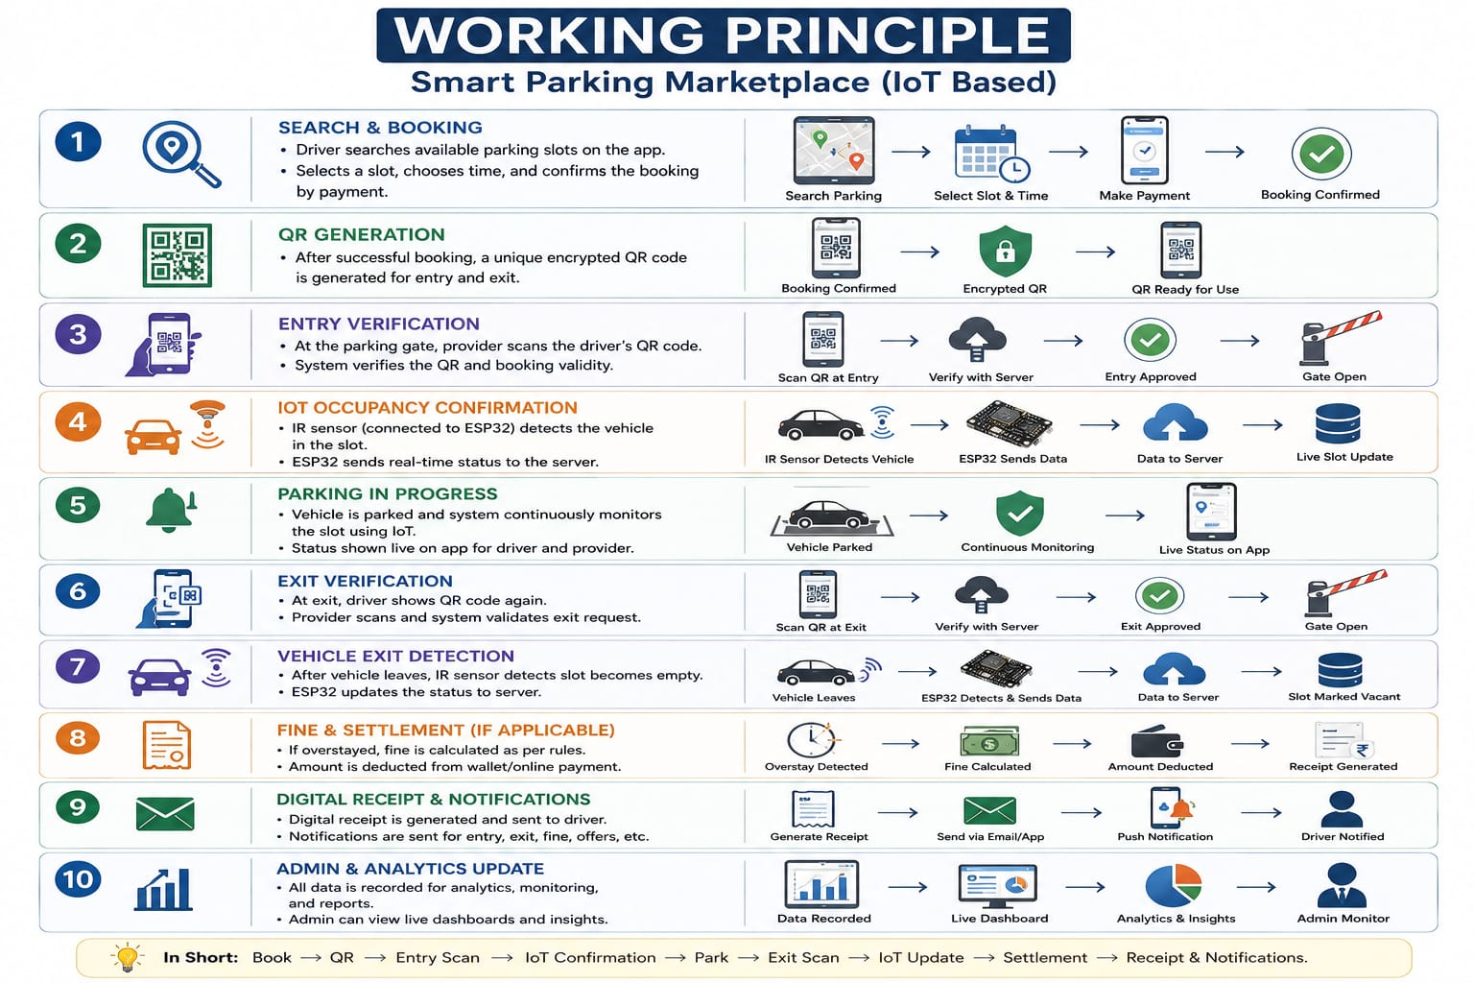
Working Principle

Slide 7
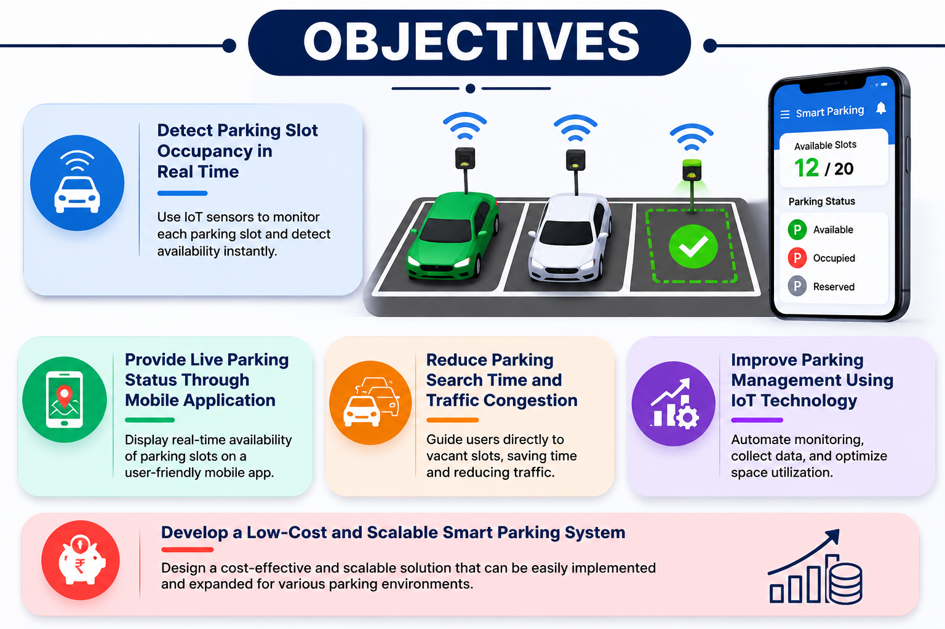
objectives

Slide 8
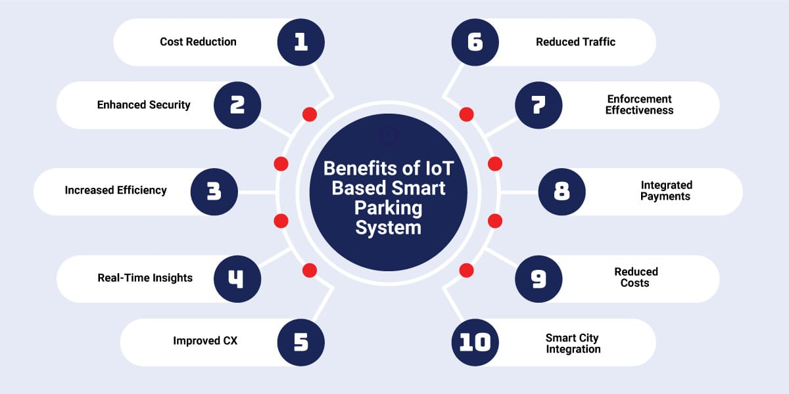
benefits

Slide 9
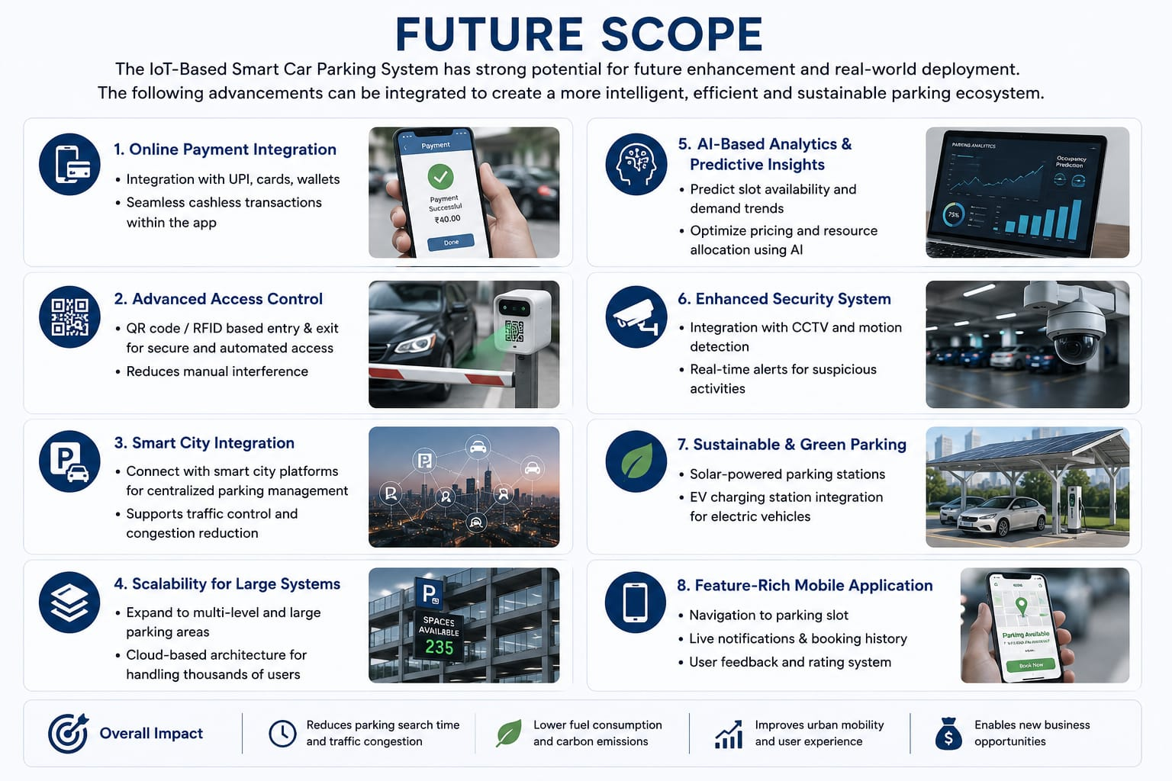
Future scope

Slide 10
conclusion
The IoT-Based Smart Car Parking System offers an efficient, reliable, and cost-effective approach to modern parking management. By leveraging IoT technology, it enables real-time parking monitoring, optimizes space utilization, reduces traffic congestion, and enhances user convenience. The system provides a scalable foundation for future smart city and intelligent transportation applications.

Slide 11
Thank you

